Slide 1




Clustering Algorithm

Slide 2

Objective & Outline
Page 01

Slide 3
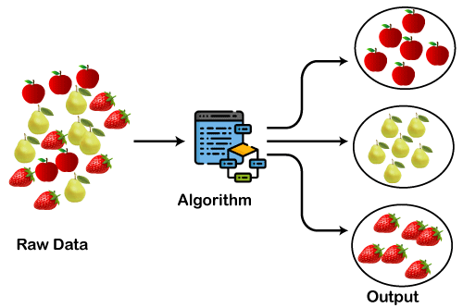
Objective & Outline
Objective
Understanding the basic concepts of clustering algorithms which are part of unsupervised learning
Outline
Review of unsupervised learning concepts
Clustering Concept
K-Means Clustering
Hierarchical Clustering
DBSCAN
Application of Clustering Algorithms
Page 02

Slide 4
Review of unsupervised learning concepts
Page 03

Slide 5
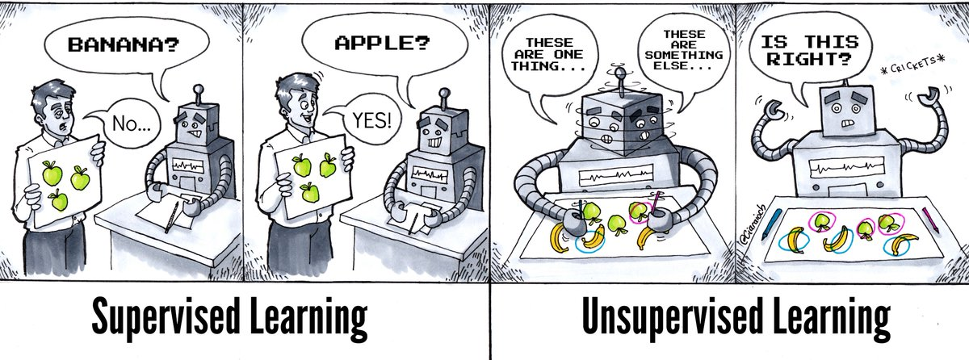
Review unsupervised learning concept
Page 04

Slide 6
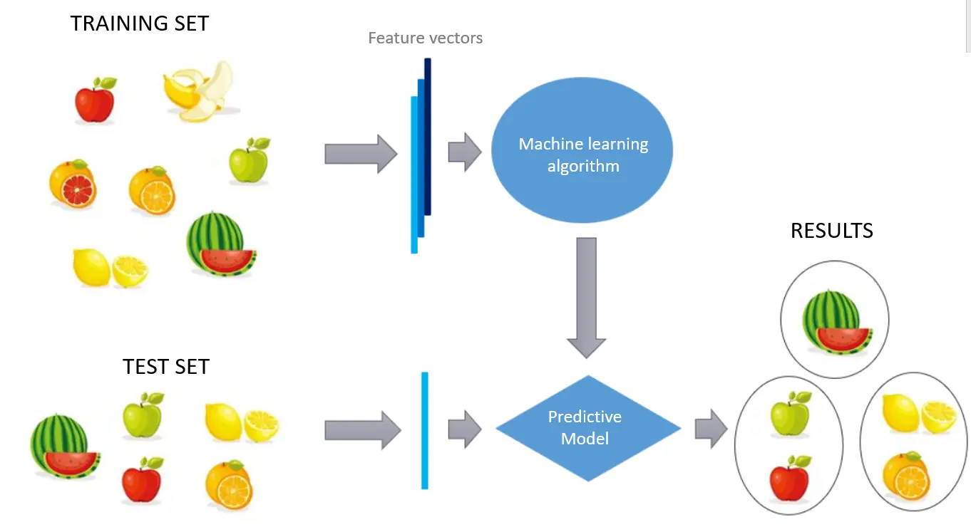
Review unsupervised learning concept
Page 05

Slide 7
Clustering Concept
Page 06

Slide 8

Clustering Concept
Clustering (or cluster analysis) is a technique that allows us to find groups of similar objects, objects that are more related to each other than to objects in other groups
Examples of applications include the grouping of documents, music, and movies by different topics, or finding customers that share similar interests based on common purchase behaviours as a basis for recommendation engines
Page 07

Slide 9
Clustering Concept
The top 3 popular clustering algorithms which is widely used in academia as well as in industry will be discussed as follows:
K-Means Clustering
Hierarchical Clustering
DBSCAN
Page 08

Slide 10
K-Means Clustering Concept
Page 09

Slide 11
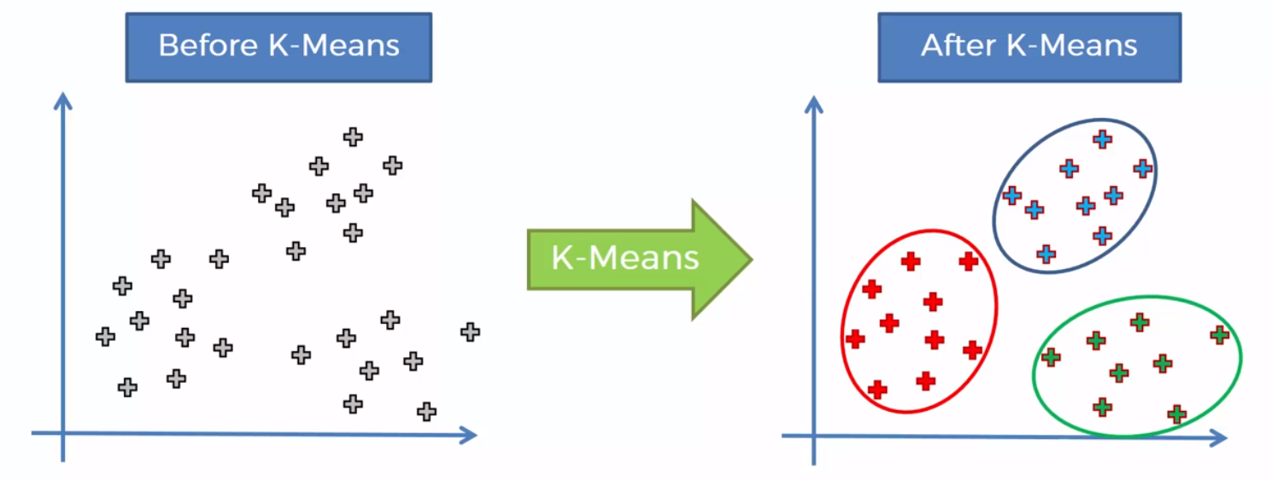
K-Means Clustering Concept
K-Means is probably the most well-known clustering algorithm. It’s easy to understand and implement in code
The K-Means algorithm clusters data by trying to separate samples in n groups of similar features.
Page 10

Slide 12
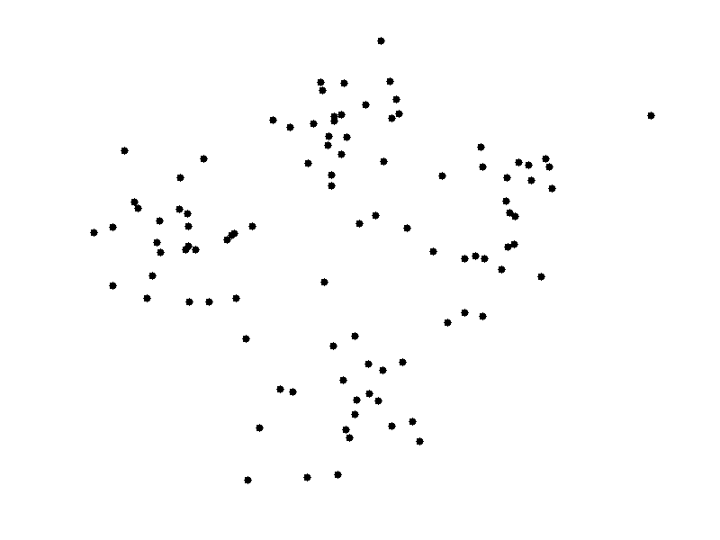
K-Means Clustering Concept
K-Means clustering is an unsupervised machine learning method that works with the following steps:
Choose number of clusters (K)
Select at random K points centroid
Assign each data point to the closest centroid that form K clusters
Recompute and place the new centroid of each cluster
Reassign each data points to the new closest centroid, if any reassignment took place do step 4 again, otherwise model is finished
Page 11

Slide 13
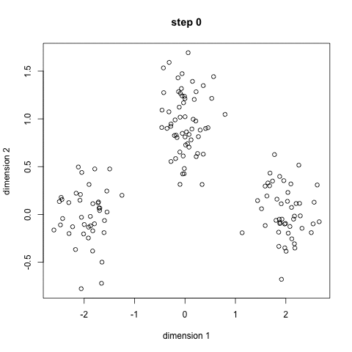
K-Means Clustering Concept
Advantages:
Faster process
Disadvantages:
Decide centroid number is not trivial
Lack of consistency due to the initial random of centroid
Page 12

Slide 14
Hierarchical Clustering Concept
Page 13

Slide 15
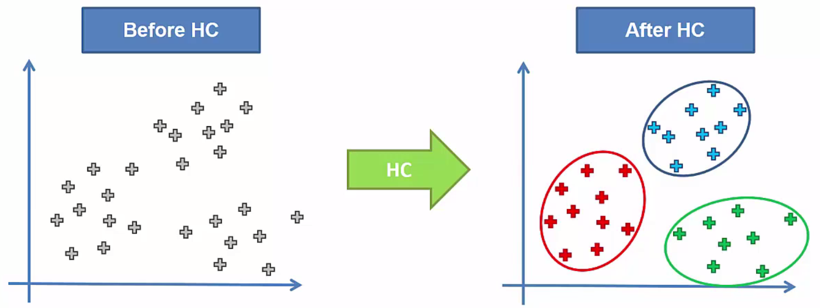
Hierarchical Clustering Concept
Hierarchical clustering is a general family of clustering algorithms that build nested clusters by merging or splitting them successively. This hierarchy of clusters is represented as a tree (or dendrogram).
The root of the tree is the unique cluster that gathers all the samples, the leaves being the clusters with only one sample.
Page 14

Slide 16
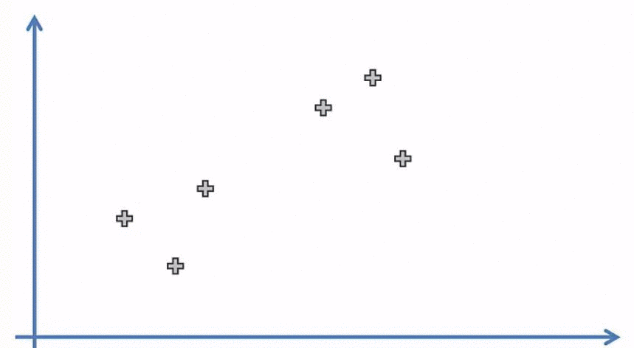
Hierarchical Clustering Concept
Hierarchical Clustering is also an unsupervised machine learning method that works with the following steps:
Make each data points a single point cluster (That forms N clusters)
Take the two closest data points ad make the one cluster (That forms N-1 cluster)
Take the two closest and make them one cluster (That forms N-2 clusters)
Repeat step 3 until there is only one cluster
Page 15

Slide 17
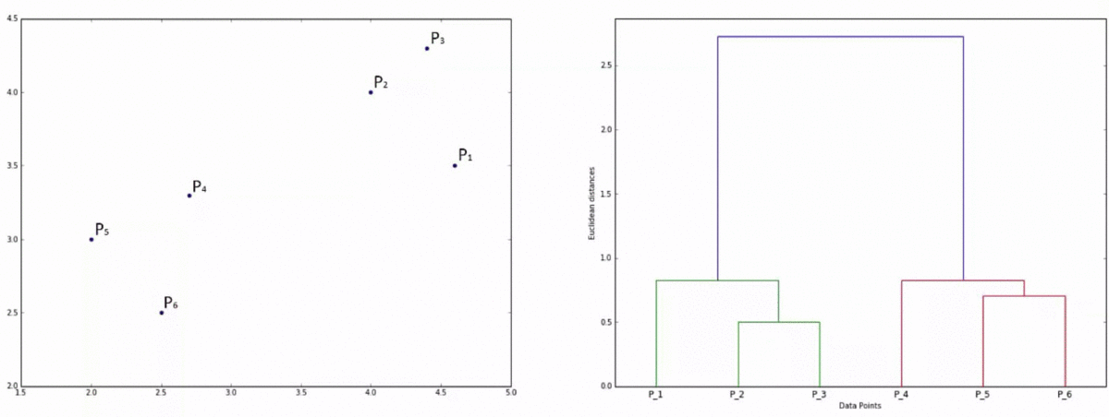
Hierarchical Clustering Concept
Page 16

Slide 18
Hierarchical Clustering Concept
Advantages:
Does not require us to specify the number of clusters
We can even select which number of clusters looks best based on the resulting tree
Good use case of hierarchical clustering methods is when the underlying data has a hierarchical structure
Disadvantages:
Lower efficiency as a cost of computation
Page 17

Slide 19
DBSCAN Concept
Page 18

Slide 20
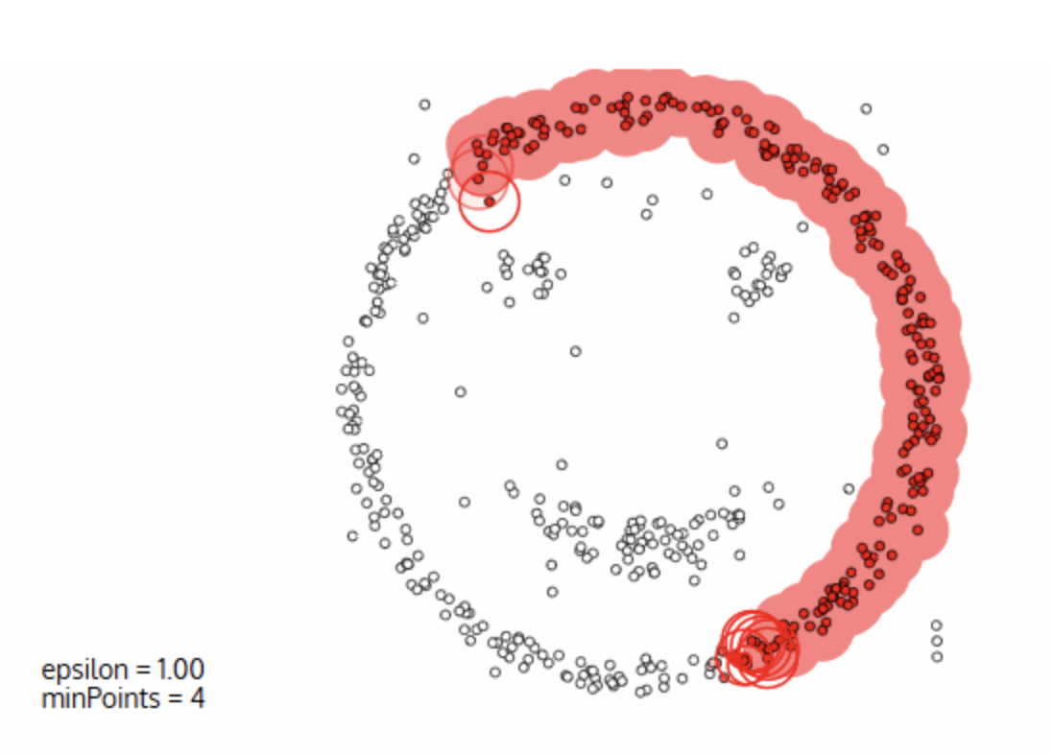
DBSCAN Concept
DBSCAN is a density-based clustered algorithm but with a couple of notable advantages. Firstly, it does not require a pe-set number of clusters at all. It also identifies outliers as noises.
Additionally, it can recognize complexly shaped clusters very well.
Click for Visualizing DBSCAN!
Page 19

Slide 21
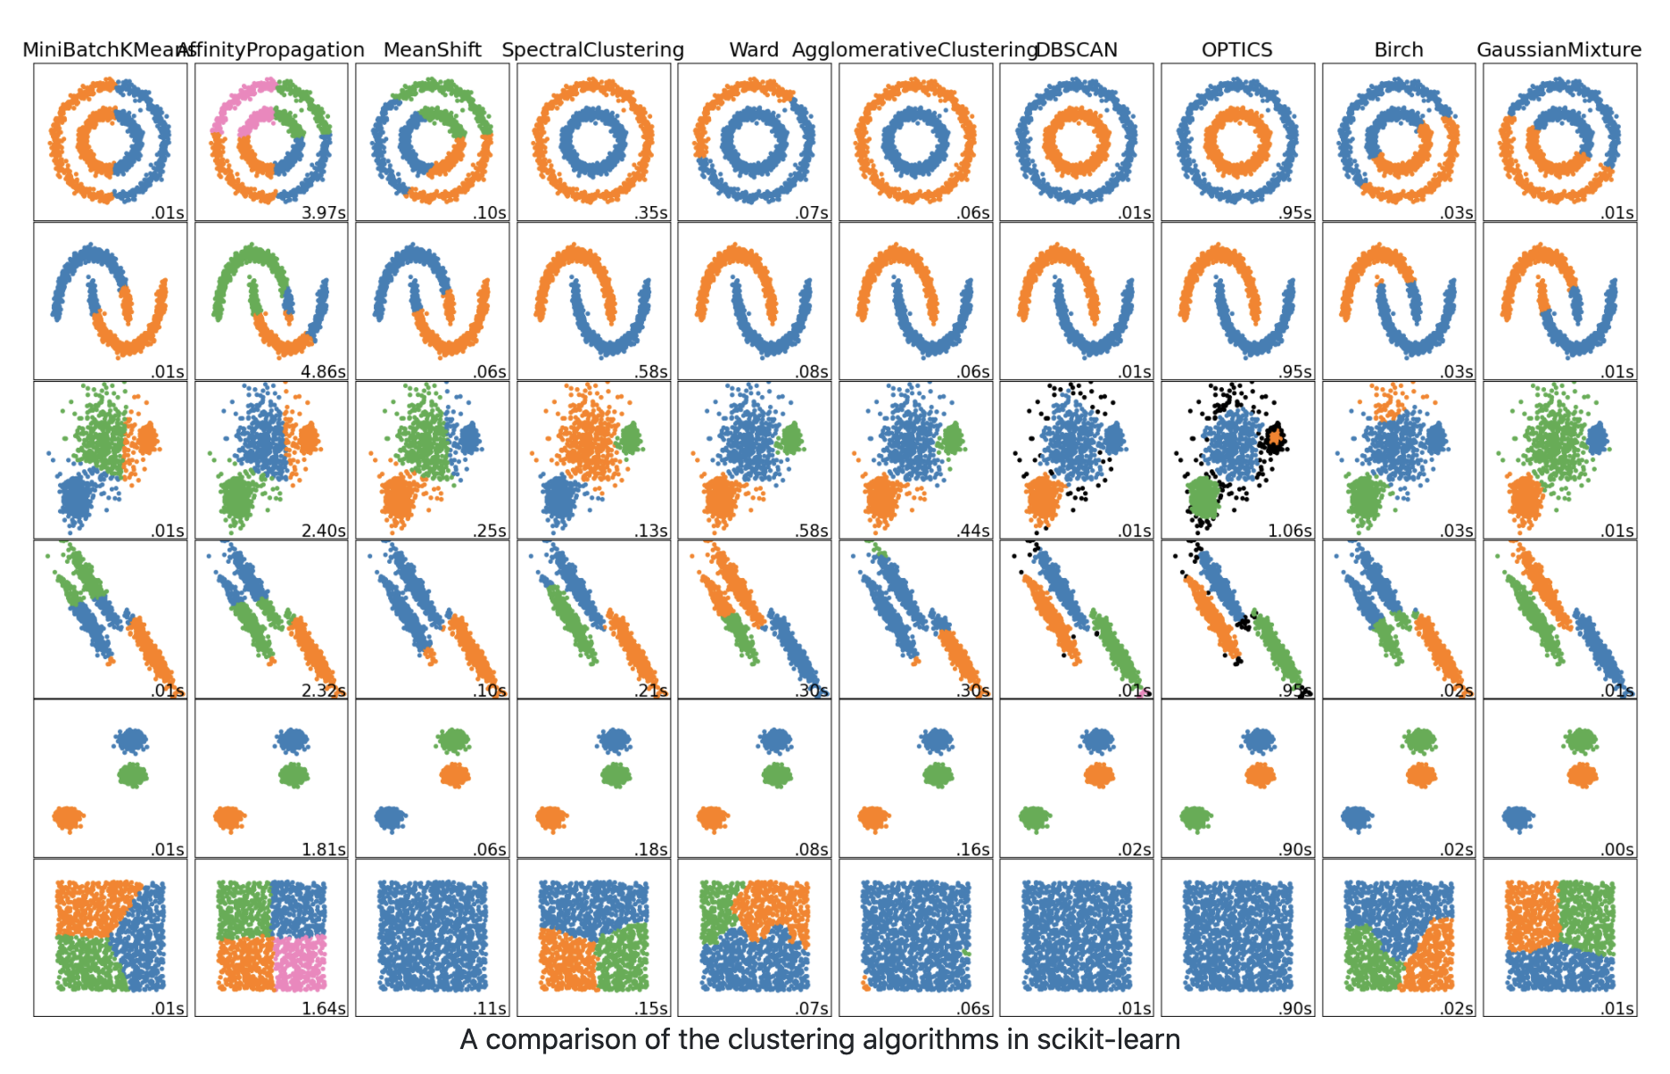
DBSCAN Concept
Page 20

Slide 22
Application of Clustering Algorithms
Page 21

Slide 23
Application of Clustering Algorithms
Identifying Fake News
Spam filter
Marketing and Sales
Classifying network traffic
Identifying fraudulent or criminal activity
Document analysis
Fantasy Football and Sports
Source : https://datafloq.com/read/7-innovative-uses-of-clustering-algorithms/6224
Page 22

Slide 24
Terima Kasih!
Indonesia AI | AI for Everyone, AI for Indonesia
contact@aiforindonesia.org

